Slide 1

Designing a Single Cycle RISCV Processor using Verilog HDL
By Anish Rooj

Slide 2
What happens when you run a c program
Suppose, a user writes a C program and runs it. What exactly happens?
1. The Compiler processes the .c file through multiple stages (preprocessing, compilation, assembly, and linking), ultimately converting it into machine-level code understood by the processor.
2. This machine code consists of low-level instructions (typically 32-bit wide for RISC architectures), which a single-cycle processor can execute step by step—one instruction per clock cycle.
3. These Instructions are loaded into memory, and the Program Counter (PC) is initialized (usually to address 0). From there, the processor begins executing instructions sequentially using the Fetch-Decode-Execute cycle.

Slide 3
What happens when you run a c program
Handles directives like #include, #define.
Expands macros, includes headers.
Result: a "pure" C file (.i).
Converts C code → assembly (machine instructions in human-readable format).
Performs optimizations, type checking, etc.
Result: an assembly file (.s).
Converts the assembly file into machine code (binary).
Each instruction becomes a binary opcode.
Result: object file (.o or .obj).
Combines all object files + standard library functions (like printf, malloc, etc.).
Resolves external symbols and addresses.
Final result: executable binary (a.out, .exe, etc.)
hellloWorld.c
Pre-processing
Compilation
Assembly
Linking
The Operating System (OS) loads the binary into RAM.
Creates a process with its own address space.
The Program Counter (PC) is set to the start of main().
IDE
Compiler
Loading into Memory
Processor
Write
Back
Memory
Access
Execute
Decode
Fetch

Slide 4
The Processor
A Processor, also known as a CPU (Central Processing Unit), is the brain of a computer or digital system. It executes instructions from a program and coordinates the operations of the system. The processor operates through a well-defined cycle:
Fetch – Retrieve the next instruction from memory (address given by the Program Counter).
Decode – Interpret the instruction to determine the required operation and operands.
Memory Access – If the instruction requires data (e.g., lw, sw), read from or write to memory at a computed address.
Execute – Perform the operation using the ALU (e.g., arithmetic, logic, branching).
Write Back – Store the result into a register or memory, depending on the instruction type.

Slide 5
Different types of instruction set computers
FEATURE | REDUCED INSTRUCTION SET COMPUTER | COMPLEX INSTRUCTION SET COMPUTER
Instruction Complexity | Simple, fixed-length instructions | Complex, variable-length instructions
Execution Time | Usually 1 cycle per instruction | Multiple cycles per complex instruction
Instruction Length | Fixed (e.g., 32 bits) | Variable (1–15 bytes in x86)
Memory Access | Load/store architecture (register-only ops) | Instructions can directly access memory
Decoding Simplicity | Easy to decode (uniform format) | Harder to decode (varied formats)
Pipelining & Parallelism | Easier to pipeline | More difficult due to complex instructions
Compiler Role | Heavily relies on compiler optimization | Less compiler effort needed
Examples | RISC-V, ARM, MIPS, SPARC | x86, VAX, Intel 8086, Motorola 68k

Slide 6
OUR goal
In this presentation, our goal is to design a Simple Single-Cycle RISC-V Processor that supports a wide subset of the RV32I base instruction set, including arithmetic, logical, memory, and control flow instructions.
We will:
i) Implement the processor using Verilog, a Hardware Description Language used for designing digital circuits.
ii) Test the processor using various RISC-V assembly programs to verify functional correctness and instruction compatibility.
iii) Focus on building a clean, modular design that follows standard Datapath and control principles.
iv) Incorporate key components like the Program Counter (PC), Instruction Memory, Register File, ALU, Data Memory, and a Control Unit to realize the full execution cycle.
v) Emphasize the fetch-decode-execute-writeback cycle, with each instruction completed in a single clock cycle.

Slide 7
The risc-v Base instructions format
The RV32I base instruction set defines six fundamental instruction formats, each tailored to specific types of operations:
R-type: Used for register-to-register arithmetic and logical operations (e.g., add, sub, and).
I-type: Used for immediate operations, load instructions, and system instructions like jalr and ecall.
S-type: Used for store instructions, where data from a register is stored to memory (e.g., sw, sb, sh).
B-type: Used for conditional branch instructions that alter control flow based on comparisons (e.g., beq, bne, blt).
U-type: Used for instructions requiring large immediate values placed in the upper bits, such as lui and auipc.
J-type: Used for unconditional jump instructions like jal, enabling long-range jumps in code execution.

Slide 8
RV32I Instruction Formats: A Classroom Analogy
The RV32I instruction set contains many instructions, but they all fit into six basic formats. You can think of these instructions like students in different classes.
To identify a specific instruction, we follow a 3-step process — similar to identifying a student in a school:
Class (Opcode) – This tells us which group the instruction belongs to (e.g., R-type, I-type, etc.).
Section (funct7) – Within a class, students may be split into different sections. This helps further narrow down the instruction's category.
Roll Number (funct3) – Finally, each instruction (student) has a unique identifier within that section.
Also, there are three different fields :
i) rs1 and rs2 – This tells us about the addresses of the source registers. Source Registers are generally operands. There are two Sources i.e. rs1 and rs2 in the Instruction Formats. rs1 and rs2 are used in R, S, and B-type instructions
ii) rd – This tells us about the address of the destination register --- register at which the result will be stored. Rd is used in R-type, I-type, J-type, U-type instructions.
iii) Imm – Finally, imm or immediate refers to a Constant value with which many operations can be done.

Slide 9
Risc-v base instruction formats
31
25
24
20
19
15
14
12
11
7
6
0
R -type
funct7 | rs2 | rs1 | funct3 | rd | opcode
I -type
Imm[11:0] | rs1 | funct3 | rd | opcode
funct7 | shamt | rs1 | funct3 | rd | opcode
I -type
imm[11:5] | rs2 | rs1 | funct3 | imm[4:0] | opcode
S -type
imm[12][10:5] | rs2 | rs1 | funct3 | imm[4:1][11] | opcode
B -type
imm[31:12] | rd | opcode
U -type
imm[20|10:1|11|19:12] | rd | opcode
J -type

Slide 10
R-type instructions
The R-type instructions is basically operation between two operands stored in two different (or same) registers. The format of the R-type Instruction is very meaningful. The rs1 and rs2 indicates two operands, the rd is the destination register at which the result will be stored. The opcode, funct3 and funct7 determines which operation is to be performed between rs1 and rs2. The opcode is constant for R-type instructions since the Class is same (Remember the class analogy?) There are several operations that are supported :
i) add rd, rs1, rs2 : As its name suggests, this instruction indicates addition operation between rs1 and rs2 i.e. (rs1 + rs2). The result is stored in the destination register rd.
ii) sub rd, rs1, rs2 : Similarly this is subtraction between rs1 and rs2. Again, the result is stored in the destination register rd
To avoid repetitiveness the following instructions are just written without any description since it is obvious from their names and the instructions which needs some clarifications are written with description:
and, or, xor (Bitwise operation between rs1 and rs2)
iii) sll rd, rs1, rs2 : This is the Shift Left Logical operation on rs1. Shifts rs1 left by amount in lower 5 bits of rs2.
iv) srl rd, rs1, rs2 : This is the Shift Right Logical operation on rs1. Shifts rs1 right (fill with zeros) by the lower 5 bits of rs2.
v) slt rd, rs1, rs2 : Signed comparison between rs1 and rs2 ---> if rs1 < rs2, then rd = 1, else rd = 0.
vi) sltu rd, rs1, rs2 : This is same as slt but unsigned comparison is done.
vii) sra rd, rs1, rs2 : This is Shift Right Arithmetic operation done on rs1. rs1 is shifted to the right by rs2 amount preserving the Sign Bit i.e. rs[4].

Slide 11
The summary of r-type instructions
Instruction | funct7 | funct3 | Operation
add | 0000000 | 000 | Add (signed)
sub | 0100000 | 000 | Subtract (signed)
sll | 0000000 | 001 | Shift Left Logical
slt | 0000000 | 010 | Set Less Than (signed)
sltu | 0000000 | 011 | Set Less Than (unsigned)
xor | 0000000 | 100 | Bitwise XOR
srl | 0000000 | 101 | Shift Right Logical
sra | 0100000 | 101 | Shift Right Arithmetic
or | 0000000 | 110 | Bitwise OR
and | 0000000 | 111 | Bitwise AND
Opcode is same for all : 0110011

Slide 12
i-type instructions
The I-type instructions is also operation between two operands but one of them is a constant provided by the user and the other is a value stored in some register. This constant value provided by the user is called immediate and it is of 12 bits, thus, it is Sign Extended to 32 bits by the Sign Extender Block. Supported I-type Instrucitons :
i) addi rd, rs1, imm : This is signed addition between rs1 and immediate i.e. rs1+imm. The result is stored at the destination register rd.
Similarly sub rd, rs1, imm
ii) xorI rd, rs1, imm : This is Bitwise XOR operation between rs1 and immediate i.e. rs1^imm. The result is stored at the destination register rd.
Similarly, andi, ori
iii) slti rd, rs1, imm : Signed Comparison between rs1 and imm : Set rd = 1 if rs1 < imm (signed)
iv) sltiu rd, rs1, imm : Same as slti but Unsigned comparison is done
v) slli rd, rs1, shamt : Logical left shift by shamt bits
vi) srli rd, rs1, shamt : Logical right shift by shamt bits
vii) srai rd, rs1, shamt : Arithmetic right shift (preserves sign)
viii) lw rd, imm(rs1) : Load 32-bit word from memory at rs1(acts as base address) + imm (acts as offset) and store it in rd.
ix) lh rd, imm(rs1) : Load 16-bit halfword (sign-extended)
x) lhu rd, imm(rs1) : Load 16-bit halfword (unsigned)
xi) lb rd, imm(rs1) : Load 8-bit byte (sign-extended)
xii) lbu rd, imm(rs1) : Load 8-bit byte (unsigned)
xiii) jalr : Used for function returns or indirect jumps. Sets rd = PC + 4 and PC = (rs1 + imm) & ~1 → clears LSB to ensure word alignment

Slide 13
The summary of I-type instructions
Instruction | opcode | funct7 | funct3 | Operation
addi | 0010011 | - | 000 | Add Immediate (signed)
slli | 0010011 | 0000000 | 001 | Shift Left Logical (Immediate)
slti | 0010011 | - | 010 | Set Less Than (signed)
sltiu | 0010011 | - | 011 | Set Less Than (unsigned)
xori | 0010011 | - | 100 | Bitwise XOR with Immediate
srli | 0010011 | 0000000 | 101 | Shift Right Logical (Immediate)
srai | 0010011 | 0100000 | 101 | Shift Right Arithmetic (Immediate)
ori | 0010011 | - | 110 | Bitwise OR with Immediate
andi | 0010011 | - | 111 | Bitwise AND with Immediate
jalr | 1100111 | - | 000 | Jump and Link Register
lw | 0000011 | - | 010 | Load Word from Memory

Slide 14
S-type instructions
S-type or Store type instructions are used to Store data from a register (rs2) into the Data Memory. These instructions do not have a destination register rd, since the value is to be stored in the Data Memory no in the Register File. The rs1 acts as the Base Address and the Sign Extended Immediate acts as the Offset. The immediate value is split between two parts:
> imm[11:5] → bits [31–25]
> imm[4:0] → bits [11–7]
These two parts are concatenated and sign-extended to form a full 12-bit offset.
So, the data is effectively stored at memory[rs1+imm]. These stored data can be accessed using the Load instructions which are I type instructions. The opcode = 0100011 is fixed for all S-type instructions.
Supported S-Type Instructions :
i) sb rs2, imm(rs1) : Store 8-bit byte from rs2 to memory[rs1+imm]
ii) sh rs2, imm(rs1) : Store 16-bit halfword from rs2 to memory[rs1+imm]
ii) sw rs2, imm(rs1) : Store 32-bit word from rs2 to memory[rs1+imm]
Instruction | funct3 | Description
sw | 010 | Store Word (32 bits)
sb | 000 | Store Byte
sh | 001 | Store Halfword

Slide 15
b-type instructions
B-type (Branch-type) instructions are used for conditional program control. These instructions compare two register values (rs1 and rs2) and change the PC to a new address (PC-relative) if the condition is true. The immediate (imm) used for the branch offset is scattered across multiple fields and must be reconstructed and sign-extended to form a 13-bit PC-relative offset :
imm = {imm[12], imm[10:5], imm[4:1], imm[11], 0}
The 0 at the end means the offset is always even (instructions are word-aligned).
The PC is Loaded with Branch Target = PC + imm which represents a Label.
Opcode = 1100011 is same for all B-type instructions
Supported Branch Type Instructions :
beq rs1, rs2, imm : If rs1 == rs2, then go to Label i.e. Branch Target = PC + imm
bne rs1, rs2, imm : If rs1 != rs2, then go to Label i.e. Branch Target = PC + imm
bge rs1, rs2, imm : If rs1 > rs2 (signed), then go to Label i.e. Branch Target = PC + imm
beq rs1, rs2, imm : If rs1 < rs2 (signed), then go to Label i.e. Branch Target = PC + imm
bltu rs1, rs2, imm : If rs1 < rs2 (unsigned), then go to Label i.e. Branch Target = PC + imm
bgtu rs1, rs2, imm : If rs1 > rs2 (unsigned), then go to Label i.e. Branch Target = PC + imm

Slide 16
Summary of B-type Instructions
Instruction | funct3 | Operation
beq | 000 | Branch if Equal
bne | 001 | Branch if Not Equal
bge | 010 | Branch if Greater or Equal (signed)
blt | 011 | Branch if Less Than (signed)
bgtu | 100 | Branch if Greater/Equal (unsigned)
bltu | 110 | Branch if Less Than (unsigned)
funct7 is not used for B-type instructions
PC + imm (13 bits) determines the Label’s address (the Address at which the PC will point)
If the condition is true, the PC is updated with:
  PC ← PC + imm
If the condition is false, the PC is incremented normally:
  PC ← PC + 4

Slide 17
J-type instructions
The J-type format is used for unconditional jumps, specifically for the jal (Jump and Link) instruction. It allows jumping to a PC-relative address, and simultaneously saving the return address (PC + 4) into a register.
To compute the jump offset, the immediate field must be reconstructed as:
imm = {imm[20], imm[10:1], imm[11], imm[19:12], 0}
Total: 21 bits after appending the 0 (LSB = 0 for alignment)
Then sign-extended to 32 bits to get the full jump offset
Final address = PC + imm
The return address is stored in the destination register rd
Opcode = 1101111 for all J-type instructions
Supported J-Type Instruction :
> jal rd, imm : Jump to PC + imm, store PC + 4 in rd
Instruction | Description
jal | Jump and Link (unconditional jump + save return address)

Slide 18
U-type instructions
U-type (Upper Immediate) instructions are used for operations that require a large immediate value, typically to set or manipulate the upper 20 bits of a register. These instructions do not perform ALU operations or memory access directly — they load or compute constants.
imm[31:12]: A 20-bit immediate constant
The lower 12 bits are automatically set to 0 (effectively a left shift by 12 bits)
The result is stored at the Destination Register rd.
Supported U-type Instructions :
> lui rd, imm : Load Upper Immediate: rd = imm << 12
auipc rd, imm : Add Upper Immediate to PC: rd = PC + (imm << 12)
Instruction | opcode | Description
lui | 0110111 | Load upper immediate into register
auipc | 0010111 | PC-relative address calculation

Slide 19
High level view of the system
A Single Cycle RISCV Processor executes instructions by coordinating two core subsystems :
i) The Datapath
ii) The Control Unit
The Datapath
The Control Unit
Program Counter
(PC)
Instruction
Memory
Register
File
Control Unit
ALU Control
PC Adder
RD1
4
0
ALU
Data Memory
MUX
Sign Extender
RD2
MUX
1

Slide 20
The datapath
The Datapath is the part of the processor that performs operations on data — such as fetching, computing, and storing — under the control of the Control Unit. The Datapath consists of :
i) The Program Counter : The Program Counter is a register that holds the address of the next instruction to execute. On every clock cycle the PC :
a) Sends its value to Instruction Memory to fetch the current instruction.
b) Gets updated to point to the next instruction (normally PC + 4 or to a branch/jump target).
ii) The Instruction Memory : A Read-Only Memory (ROM) block that stores the program's instructions (in binary format). The PC acts as an address input to this memory. Outputs a 32-bit instruction based on the PC’s value. Operates synchronously with the clock.
ii) The Register File : A set of 32 registers (x0 to x31), each 32 bits wide. These registers are also called General Purpose Registers or GPR. Reads values from source registers rs1 and rs2. Writes the result to rd if RegWrite signal is active.
iv) Sign Extender : Extracts the immediate (constant) field from the instruction based on its format (I-type, S-type, etc.). Performs sign-extension (e.g., a 12-bit imm is extended to 32 bits with sign bit replicated). The generated immediate is used as a second operand in ALU operations or address offset in memory and branch instructions.
v) PC Adder : A Simple Full Adder which adds a constant 4 (in decimal) to PC. It accepts PC’s output and generates PC+4 which is given to the Program Counter as an Input to point to the next Instruction.
vi) ALU : Performs core Arithmetic and Logical operations like add, or, xor, sub, compare etc. Its Inputs are rs1(fixed) and rs2 or Immediate. Its outputs are Zero and ALUResult.
vii) MUX : A simple 2:1 MUX which selects between the Data coming from the Data Memory (0) and the ALU Result (1). The purpose of this MUX is to differentiate between Store and other instructions.
Also, there is another MUX before ALU input 1 to select imm or RD2. The selector signal is ALUSrc which comes from the Control Unit.

Slide 21
The control unit
The Control Unit is responsible for decoding the instruction and generating control signals that drive the datapath components (registers, ALU, memory, multiplexers, etc.). It consists of two main parts:
Main Control Unit – This unit takes the 7-bit opcode from the instruction and produces control signals that affect the entire Datapath. Based on the opcode, this block produces various control signals to Datapath.
ALU Control : The ALU Control Unit is responsible for selecting the exact operation that the ALU must perform, based on:
  Instruction type (R-type, I-type, Branch, Load/Store)
  funct3 and funct7 fields from the instruction
  A higher-level control signal: ALUOp (2 bits), generated by the Main Control Unit
These two modules will be discussed in great details in the Designing section.

Slide 22
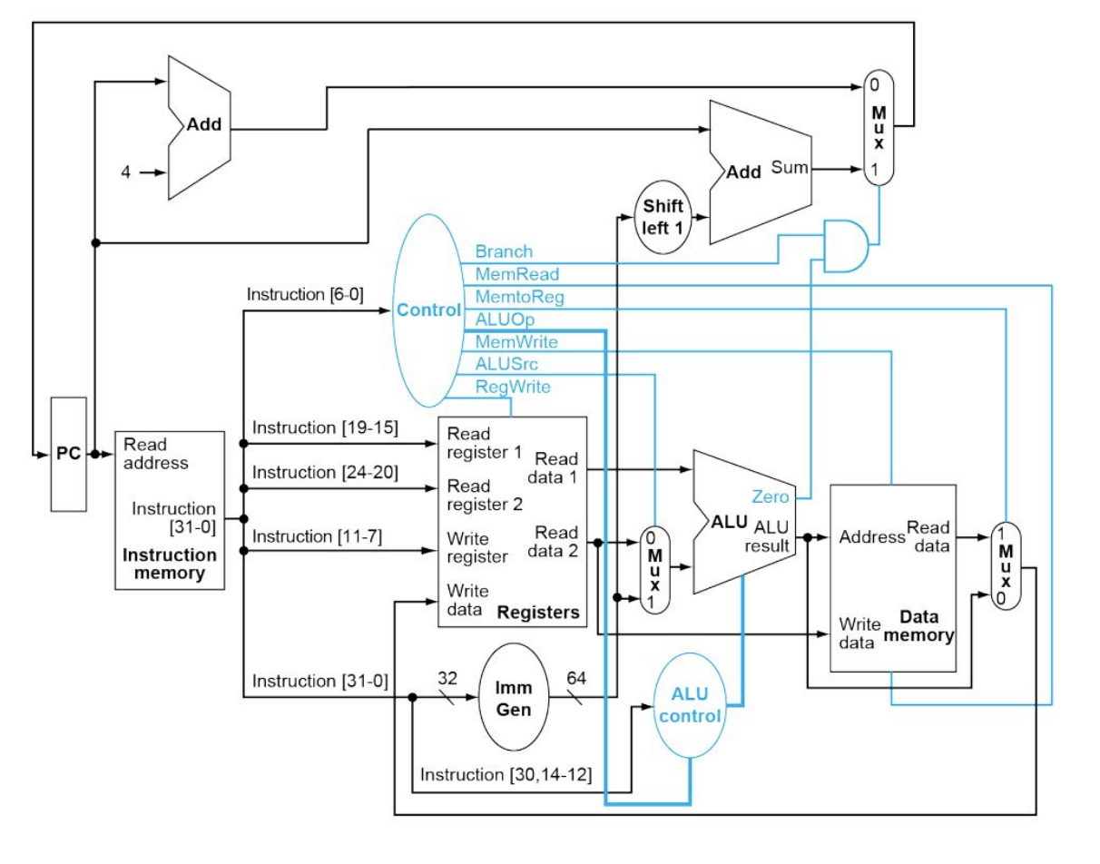
The overall system
This diagram illustrates the complete integration of the Datapath and the Control Unit, forming the core of the single-cycle RISC-V processor. Each connection shown is critical for executing instructions correctly in one clock cycle.
Notice that the PC is loaded with PC+4 or PC + some offset depending upon the Branch (from the Control Unit) and the Zero (from the ALU). This is due to the fact that the Branch instructions can be used to jump to different locations.
This picture is taken from Computer Organization and Design by David A. Patterson and John L. Hennessy

Slide 23
Designing the control unit
Our first step will be to design the Control Unit which will send Control Signals to the Datapath. As, discussed previously, the CU consists of a Main Control Unit and an ALU Control Unit. We will start designing the Main Control Unit first since it sends the ALUOp signal to the ALU Control Unit.
The Main Control Unit (controlUnit.v)
This block accepts the opcode (7 bits) as its input and produces necessary control signals. Its outputs are :
> ALU Op :
Signal | Purpose
ALUOp (2 bits) | Guides the ALU Control on which operation category to perform: - 00 = ADD (loads/stores) - 01 = SUB/SLT (branches) - 10 = Decode funct3/funct7 (R/I-type).
Jal | Indicates a jump-and-link (JAL) instruction. Updates PC and writes PC+4 to rd.
Jalr | Indicates a jump-and-link-register (JALR) instruction. Uses rs1 + imm for jump target.
Signal | Purpose
RegWrite | Enables writing to the register file (for rd).
ALUSrc | Selects between rs2 (0) or an immediate (1) as ALU input.
MemtoReg | Selects whether ALU result (0) or memory read data (1) is written back to rd.
Signal | Purpose
MemRead | Enables reading from data memory (for lw).
MemWrite | Enables writing to data memory (for sw).
Branch | Indicates a branch instruction (beq, bne).
Signal | Purpose
Lui | Indicates load upper immediate (LUI). Writes imm << 12 to rd.
Auipc | Indicates add upper immediate to PC (AUIPC). Writes PC + (imm << 12) to rd.

Slide 24
Designing the control unit
The main purpose of this block is to determine the Class based on the opcode. There are 9 distinct opcodes representing R (opcode = 0110011), I (0010011), Load (0000011), Store (0100011), Branch (1100011), Jal (1101111), Jalr (1100111), LUI (0110111) and AUIPC (0010111). The control signals will be decided based on these opcodes. For example, if opcode = 0110011 i.e. R type Instruction :
ALUSrc = 0 → Indicates that there is no Imm in the instruction, so, choose the ALU input 1 (Remember there is a MUX before ALU input 1) to RD2 (coming from the Register File).
RegWrite = 1 → Tells the Register File to Write the Available data into the destination register rd.
ALUOp = 2’b10 → Tells the ALU Control Block that this might be R or I type instruction, so further check funct3 and funct7.
We will naturally use case statement in Verilog under an always combinational block. The control signals will have a default value of zero.
ALUOp
Control
Unit
MemtoReg
MemRead
opcode
MemWrite
ALUSrc
RegWrite
Branch
Jal
Jalr
LUI
AUIPC
> A Natural Question may arise that how are we deciding the ALU Op ? Is it random or is it our choice ?
> The answer is, yes, it entirely depends on the Processor Designer. If you, assign different ALU Op, then accordingly you have to design the ALU Control.
> The ALU Op basically helps us to distinguish between Memory Access (Load and Store), Branch and R-I type instructions.
> In many books, it is decided to use the following convention for the ALU Op :
00 : Load and Store 10 : R-I type instr
01 : Branch 11 : Invalid

Slide 25
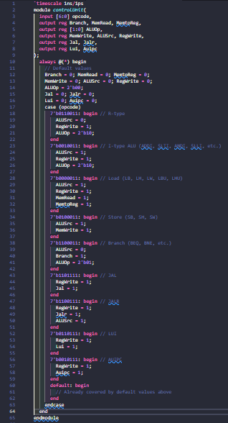
The Verilog code for the control unit

Slide 26
Designing the alu control block
The ALU Control Block will accept the ALU Op (2 bits) from the Control Unit and produces an ALU Control Signal (4 Bits) which will be further accepted by the ALU to decide which operation is to be performed. So, the ALU Control Block has to decide which operation is to be performed. To design this block, we will use some observations :
For Memory Access instructions (Load and Store) we only add (signed) the rs2 with imm. So, if ALU Op = 00, the ALU should perform Addition operation. The ALU Control for Addition is 0010.
For Branch type instructions :
  For beq, bne (funct3 = 000, 001 respectively) we subtract rs2 from rs2, so the ALU should do Subtraction operation. The ALU Control for Subtraction is 0010.
  For blt, bge (funct3 = 100, 101 respectively) we do signed comparison between rs1 and rs2, so the ALU should do the same. The ALU Control for Signed Comparison is 0011.
  For bltu, bgeu (funct3 = 110, 111 respectively) we do unsigned comparison between rs1 and rs2, so the ALU should do the same. The ALU Control for Unsigned Comparison is 1000.
For R and I type instructions :
  The fucnt7 is 0000000 always except for two subtraction and shift right arithmetic operations. So, when funct7 == 000000, according to funct3 we will decide the ALU Control. Please refer to the tables shown in the previous slides.
  When funct7 is not 0000000, we will again decide the operation (whether subtraction of shift right arithmetic) based on the funct3. Accordingly we will set the ALU Control.

Slide 27
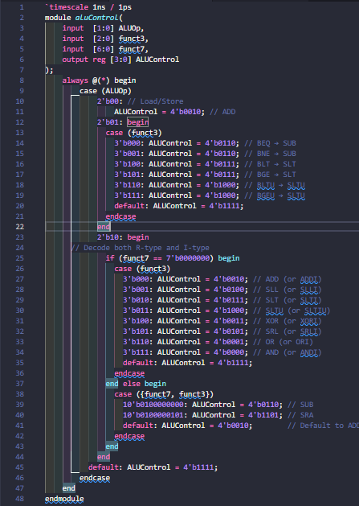
The Verilog code for the alu control block

Slide 28
Designing the arithmetic logic unit (alu)
ALU Control | Operation
0000 | Bitwise AND
0001 | Bitwise OR
0010 | Addition
0011 | Bitwise XOR
0100 | Shift Logical Left
0101 | Shift Logical Right
0110 | Subtraction
0111 | Signed Comparison
1000 | Unsigned Comparison
1101 | Shift Right Arithmetic
The ALU accepts the ALU Control signal generated by the ALU Control Block and decides which operation to perform
It accepts two operands : rd1 (fixed) and rd2 or imm depending on the ALU Src
The output of the Zero is HIGH if the Result == 32’b0
A
32
ALU
32
Result
B
Zero
32
4
ALU Control

Slide 29
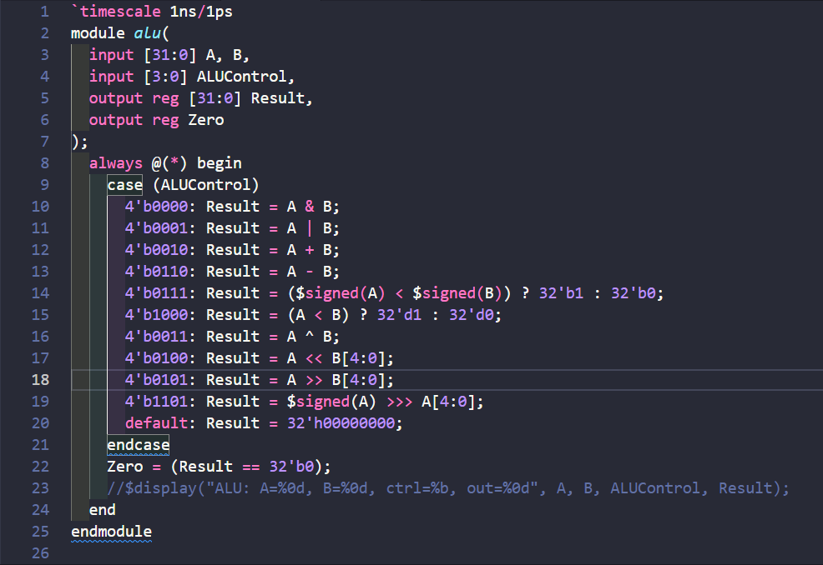
THE VERILOG CODE FOR THE ALU

Slide 30
DESIGINING THE SIGN Extender
The Sign Extender Block extends the sign of the immediate to make it 32 bits signed number, since the ALU does many Signed operation with Immediate. This block accepts opcode (7 bits) and the instruction (32 bits). Depending upon the opcode, the sign of the immediate is extended. To design this block we need to carefully observe the Base Formats shown in the previous slide :
> For I-type instructions, the lower 12 bits of the immediate is equal to the upper 12 bits of the instruction. So, we need to sign extend the remaining 20 bits. Hence, the upper 20 bits of the immediate will be same as the MSB of the instruction i.e. instruction[31].
For S-type instructions, the lower 5 bits of the imm is equal to the inst[11:7] and the imm[11:5] instr[31:25]
The rest of the sign extension logic is similar : See the base format and assign imm according to the diagram.
This block generates sign extended Immediate which is the input to the ALU MUX (the mux before the ALU whose selector signal is ALU Src : Selects between RD2 and Imm depending upon the instruction)
The default value of the immediate produced by this block is 32’b0

Slide 31
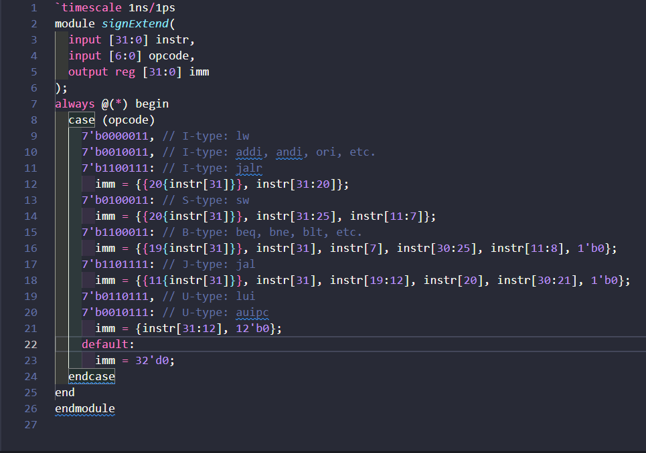
The Verilog code for the Sign extender

Slide 32
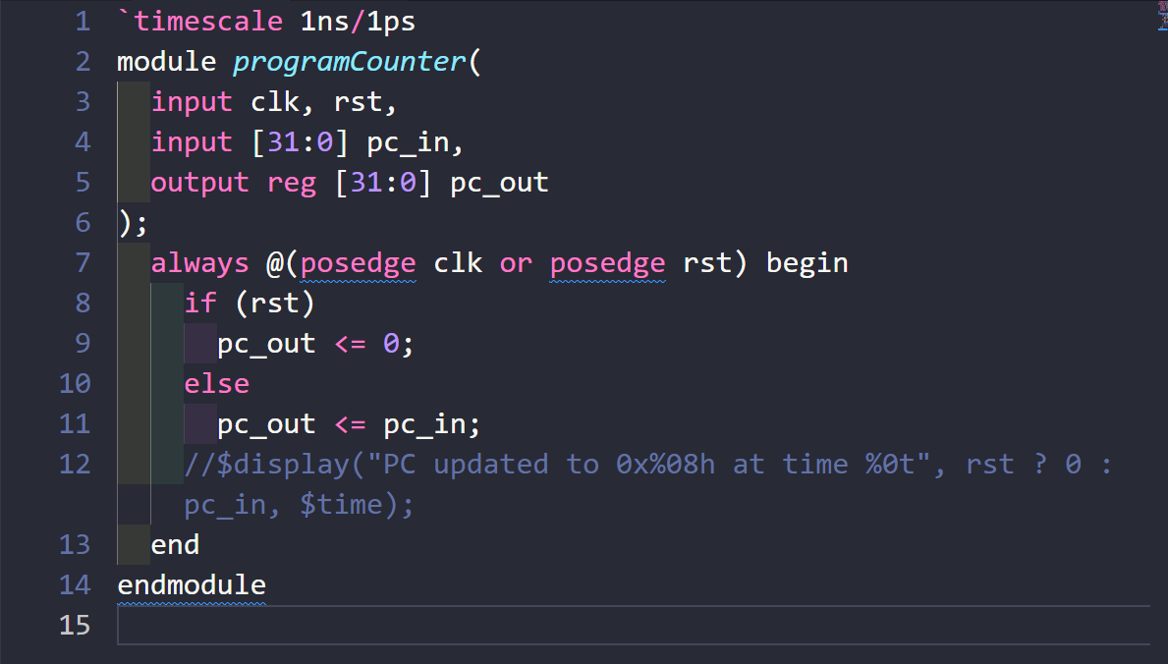
Designing the program counter
The Program Counter is nothing but a simple Positive Edge Triggered D Flip Flop with Asynchronous Active High Reset. It accepts the Next address of the instruction and outputs the same in the Positive Edge.
VERILOG CODE FOR THE PROGRAM COUNTER

Slide 33
DESIGNING THE INSTRUCTION MEMORY
The Instruction Memory in a RISC-V single-cycle processor behaves as a Read-Only Memory (ROM) that holds machine instructions encoded in 32-bit format. It plays a critical role in the Fetch stage of the instruction cycle.
Word Alignment : Word alignment means that instructions are stored at memory addresses that are multiples of 4 bytes (i.e., 0x00000000, 0x00000004, 0x00000008, …).
Therefore, the lower 2 bits of the PC are always 00 in binary.
Thus, we usually ignore the lower two bits. In this design, we assume a fixed-size Instruction Memory capable of storing 256 instructions.
Total memory range: 0 to 255 words = 256 × 4 = 1024 bytes = 1 KB
The PC can address locations from 0x00000000 to 0x000003FC (in 4-byte steps).
Internally, instruction memory is indexed using:
  instr_mem[PC[9:2]] // 8-bit word index

Slide 34
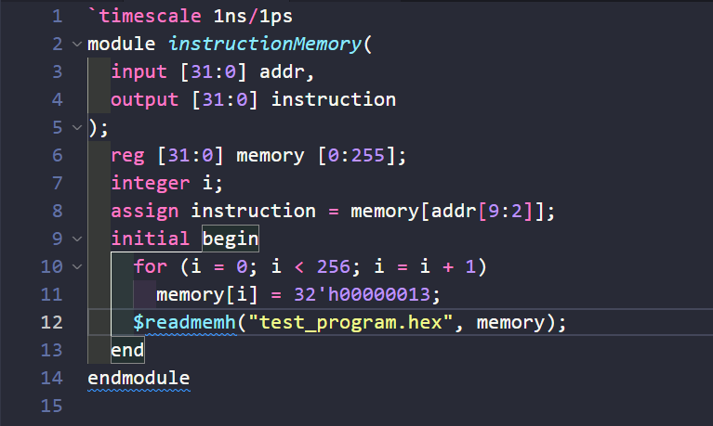
The Verilog code for the instruction memory
$readmemh statement reads the .hex file in which Instructions are stored in hex format (eg FE5098E3)
Notice that the instructions are fetched Asynchronously. This enables zero-latency access.

Slide 35
Designing the register file
The Register File is kind of a collection of registers. It has 32 (0-31) registers inside it, these are also called General Purpose Registers (GPR). This Block has two Read Ports (rs1, rs2), one Write Port (rd). It accepts the Write Data (32 Bits) produced by the Data Memory, the RegWrite control Signal coming from the Control Unit and a clock.
Input | Width | Description
clk | - | Clock signal. Writing to a register occurs on the rising edge.
rs1 | 5 | Address of source register 1.
rs2 | 5 | Address of source register 2.
rd | 5 | Address of destination register (write-back target).
writeData | 32 | Data to be written into register rd when RegWrite is high.
regWrite | 1 | Write enable signal. When high, data is written into register rd.
Output | Width | Description
readData1 (RD1) | 32 | Data read from register rs1
readData2 (RD2) | 32 | Data read from register rs2

Slide 36
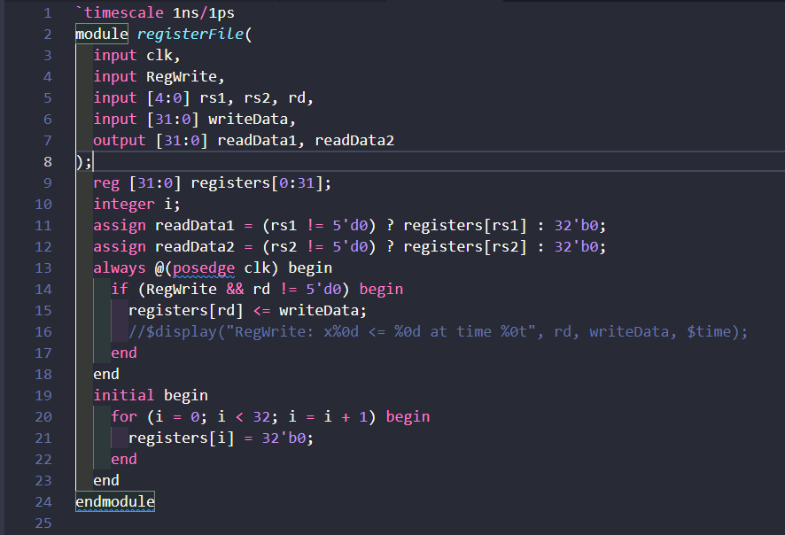
Verilog code for the register file
The data is read asynchronously from rs1 and rs2 but only when rs != 0. But why? The reason is that the x0 (GPR0) is Hardwired to 32’b0 and any read from x0 always results in 32’b0
The writeData is stored at the destination register only if rd != 5’d0 to protect register x0 to be written.
At the start of the simulation, all the GPR are initialized to 32’b0 using initial block (non synthesizable).

Slide 37
Designing the data memory
The Data Memory is a RAM with Asynchronous Read. In this design will choose a 1KB RAM.
It accepts MemWrite, MemRead from the Control Unit, writeData from the Register File (readData2 or RD2). The address comes from the ALU (Result).
Input | Width | Description
clk | - | Clock input, used for synchronous writes
addr | 32 | Memory address (byte address)
writeData | 32 | Data to be written to memory (for store) when MemWrite is HIGH
MemWrite | 1 | When high, enables memory write
MemRead | 1 | When high, enables memory read
Output | Width | Description
readData | 32 | Data read from memory (for load)

Slide 38
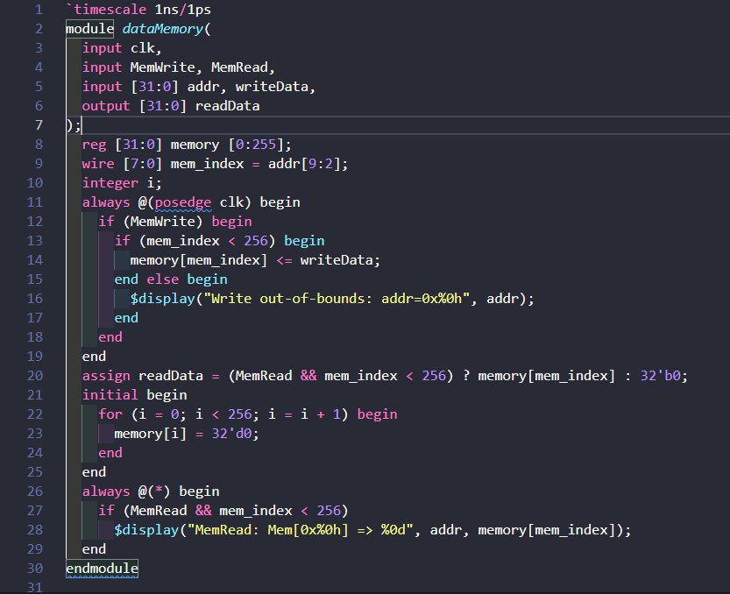
The Verilog code of the data memory
Again, the Word Align is used
The Data is Read Asynchronously
Some Debugging and Error Prevention statements have been added
The Data Memory is initiliazed to zero to prevent showing xxx in the starting of the Simulation

Slide 39
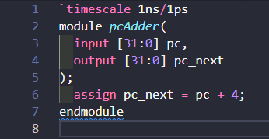
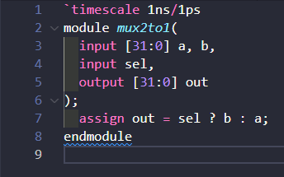
Designing the pc adder AND THE MUX
The PC Adder is nothing but a Full Adder which adds a constant 4 (in decimal) to point at the next instruction.
VERILOG CODE FOR THE PC ADDER
The MUX is a simply 2:1 MUX which selects one of its input depending upon the Selector signal.
VERILOG CODE FOR THE PC ADDER

Slide 40





Putting all together : Designing the Top Module
The Top Module or the overall System (The Processor) will be designed according to the Block Diagram of the Overall Architecture (taken from the Computer Organization and Design by David A. Patterson and John L. Hennessy).
Just some minor changes will be done to add the jal, jalr, lui and auipc instructions. Also, we are not using the shift + 1 block since it will be handled in the Top Module.
The inputs of the Top Module i.e the Processor is clk and rst.
i) First, we will configure the Program Counter.
ii) Next, we will connect the output of the PC to the PC Adder.
iii) Next, the the instruction memory is to be configured.
iv) Now, we will extract the rd, rs1, rs2, funct3, funct7 and opcode from the instruction.
v) Next comes the Register File.

Slide 41



The top module
vi) Now, we will set up the Sign Extender block.
vii) Next, the Control Unit.
viii) Next, the ALU Control.
ix) Next, the ALU MUX.
x) Next, the ALU.
xi) Now, the Data Memory.
xii) Next, the Memory Mux.
xiii) Now, we will tackle the jal, jalr, lui,
auipc instructions. Recall that, for both jal and jalr instructions, we store PC + 4 (the return address) in the destination register rd. Also, we store PC and PC + imm in rd for lui and auipc respectively. So, for jal or jalr (i.e. jal | jalr) we store PC + 4, for lui and auipc we will store PC and PC + imm respectively.

Slide 42
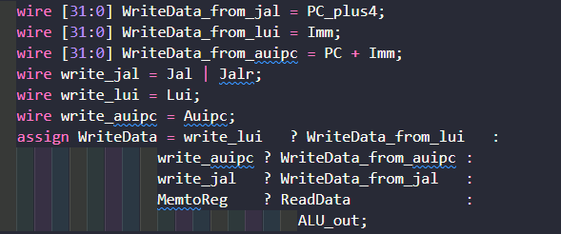
The top module
For none of the lui, auipc, jal, jalr we will pass the ALU Result.
xiii) Finally, we will configure the Branching and Jumping logic.
For this, we have to recall Branch and Jump type instructions.
The Branch type instructions and jal loads the Program counter to point to
some label (an address) which is basically doing the current address plus some immediate.
Again, for jalr we load the PC to point to the RD1 + imm (i.e. to the address stored in rs1 + imm)
For none of Branch, jal or jalr we simply loads the PC to PC + 4 to point to the next instruction.
We will take branch only if Branch signal from the CU is high i.e. it is indeed a Branch Instruction and any of the beq, bne, blt, bge, bltu and bgeu is TRUE. Otherwise we will not take branch i.e. the condition is FALSE.
beq is TRUE if ALU Result is Zero (since A – B = 0) and funct3 = 000
bne is TRUE if ALU Result is not Zero (since A != B, A – B != 0) and funct3 = 001
blt is TRUE if the LSB of the ALU Result = 1 (for comparison the whole ALU Result is 1 if A < B and the whole ALU Result is 0 if A > B, so, we are just choosing the LSB, you could choose the whole ALU Result if you want) and funct3 = 100
bge is TRUE if the LSB of the ALU Result != 1 (i.e. A > B) and funct3 = 101
bltu and bgeu is TRUE just like blt and bge respectively and funct3 = 110 and 111 respectively

Slide 43
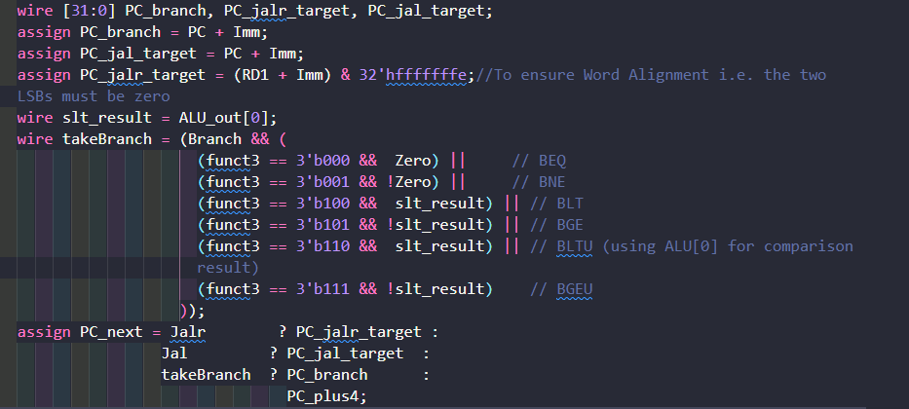
The top module
So, from the above discussion, we will load the PC accordingly.
For jalr, we have ANDed 32’hfffffffe to
ensure word alignment i.e. to make sure that
the two LSB bits of the jalr_target is indeed
0.
We have designed the Top Module following the classic Diagram of the RISCV Architecture, step by step, module by module. In many cases, we have used redundant wires for education purpose only.

Slide 44
Testing and simulation
We have written all the Verilog Codes in the EDA Playground for sharing purpose. The Processor has been tested with different programs like Fibonacci Series, GCD, Bubble Sort, Sum of N natural number etc. Steps to run a program using this Processor :
i) Write the program in Assembly Language.
ii) Use an Assembler (RISCV toolchain) to get the .hex file.
iii) Make a .hex file and change the name of the file in the instructionMemory.v or just paste the contents of your .hex file in the test_program.hex
iv) Just Save and Run the Simulation!
v) A test bench is already provided
Link to EDA Playground : RISCV Single Cycle Processor - EDA Playground
Links to my GitHub :
i) Verilog Based Implementation : https://github.com/Anish-Rooj-cpu/Single-Cycle-RISCV-Processor-using-Verilog-HDL
ii) Digital Software Based Implementation (way cooler and you can easily see what really is going on inside the Processor!) : https://github.com/Anish-Rooj-cpu/Single-Cycle-RISCV-Processor-using-Digital-Software
Finally, let's connect on LinkedIn : www.linkedin.com/in/anish-rooj-6b6746275

Slide 45
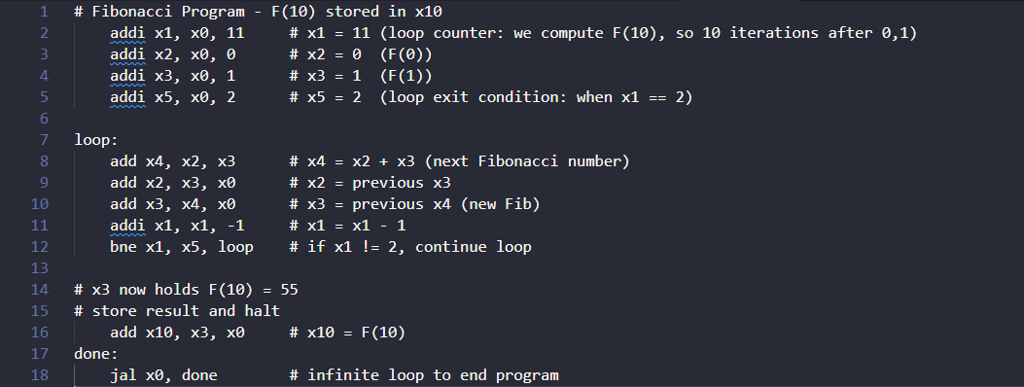
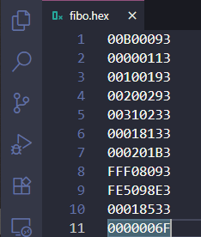
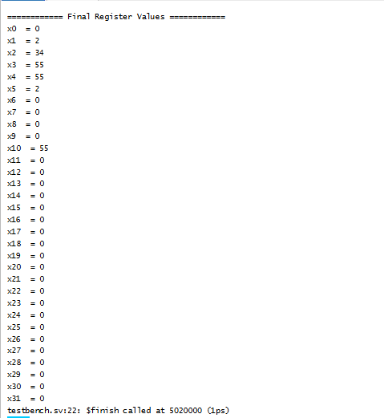
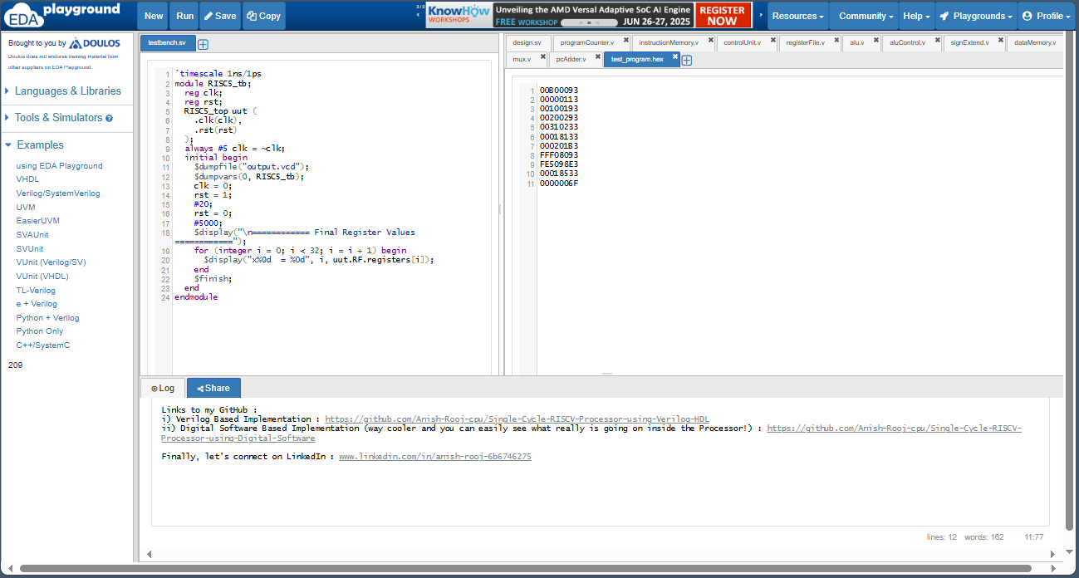
A test Program

Slide 46
references
1. David A. Patterson, John L. Hennessy
Computer Organization and Design: The Hardware/Software Interface (5th Edition, RISC-V Edition)
2. RISC-V Instruction Set Manual Volume I: User-Level ISA Version 2.2
https://riscv.org/specifications/
Official specification for RV32I base integer instruction set architecture. Critical for instruction formats and behavior.
3. Wikipedia Contributors RISC-V – Wikipedia Entry : https://en.wikipedia.org/wiki/RISC-V
Provides a quick, readable summary of the RISC-V architecture, licensing, and ecosystem.
4. Fraser Innovations Blog RISC-V Instruction Set Explanation
https://fraserinnovations.com/risc-v/risc-v-instruction-set-explanation/
5. Verilog HDL by Samir Palnitkar

